Slide 1
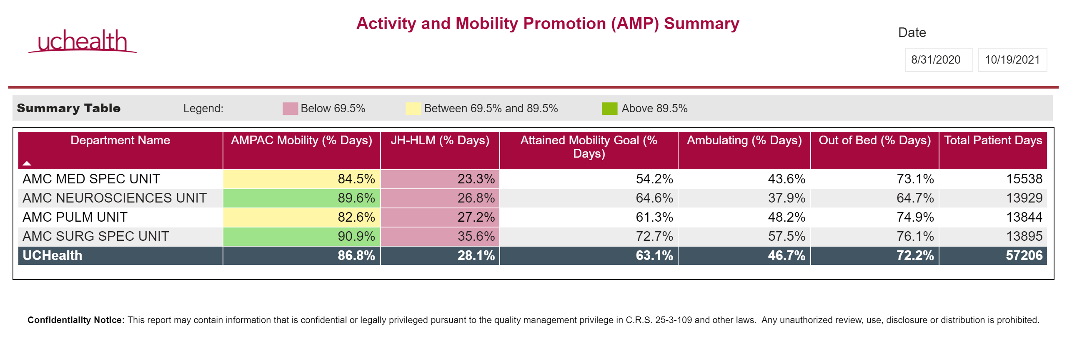
Summary

Slide 2
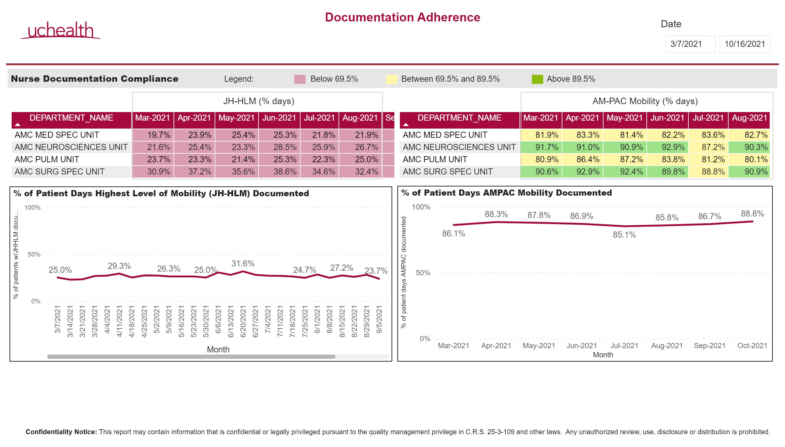
Documentation Adherence

Slide 3
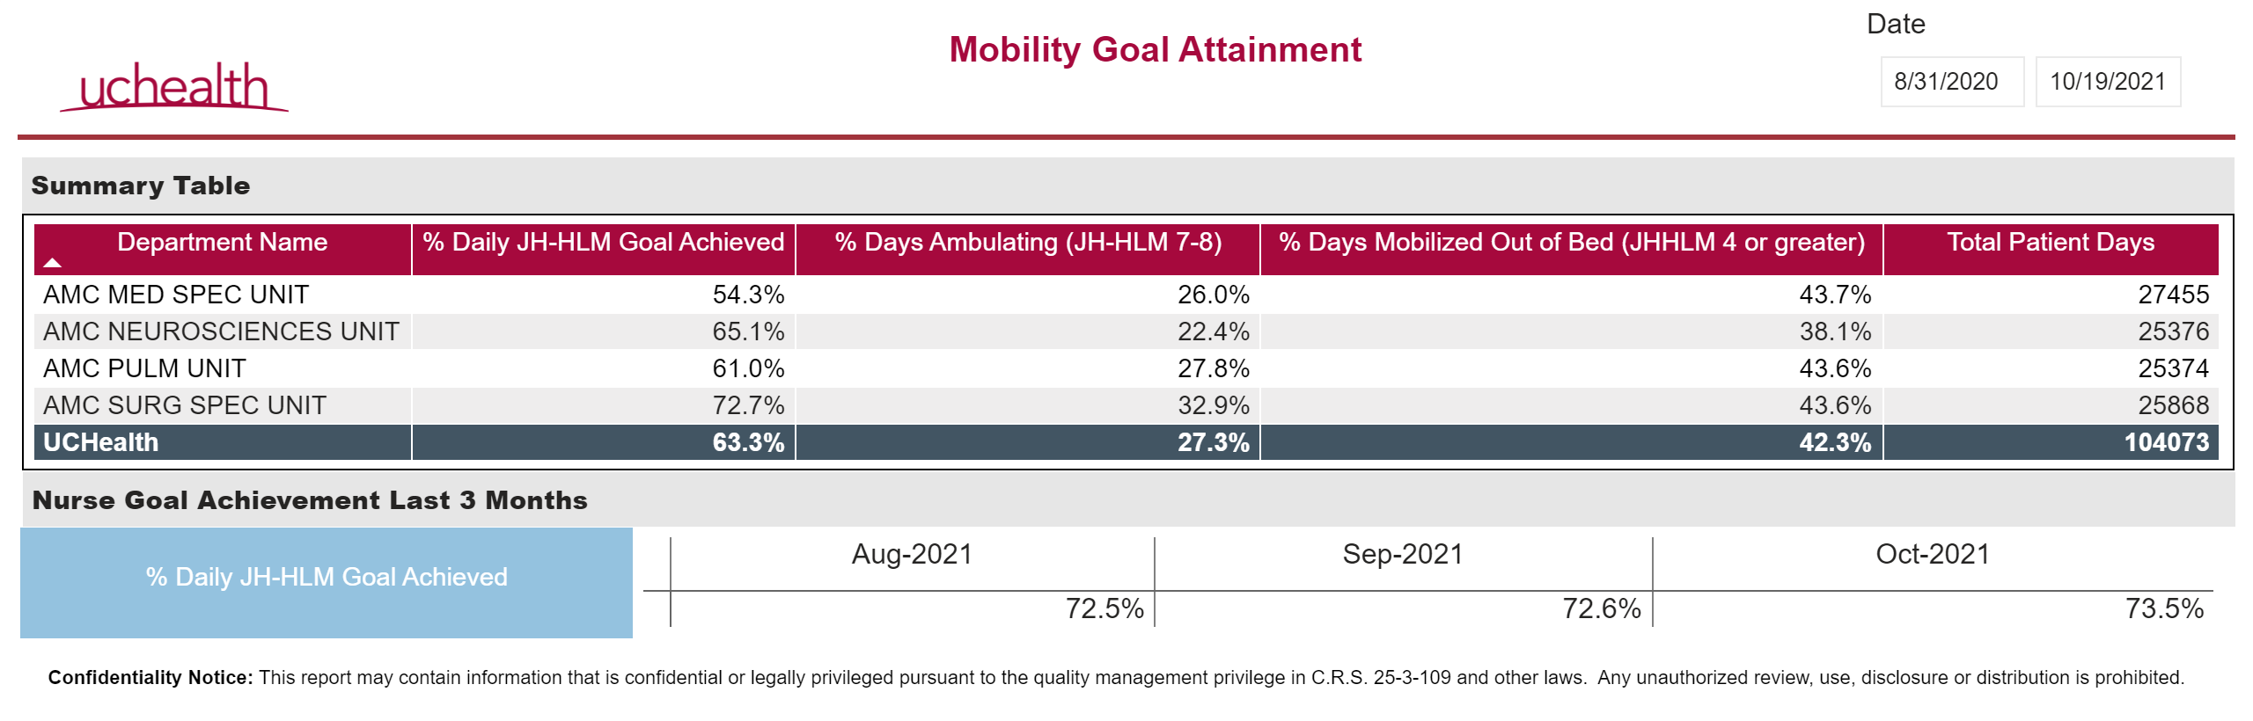
Mobility Goal Attainment

Slide 4
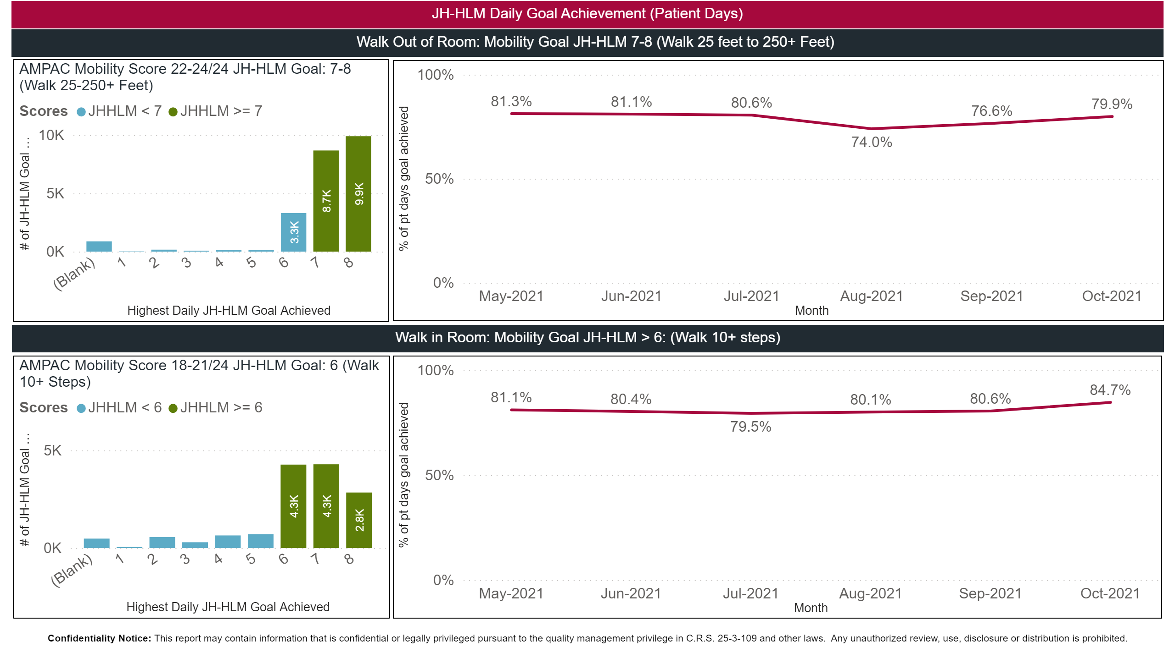
JHHLM_Goal_Achievement_page1

Slide 5
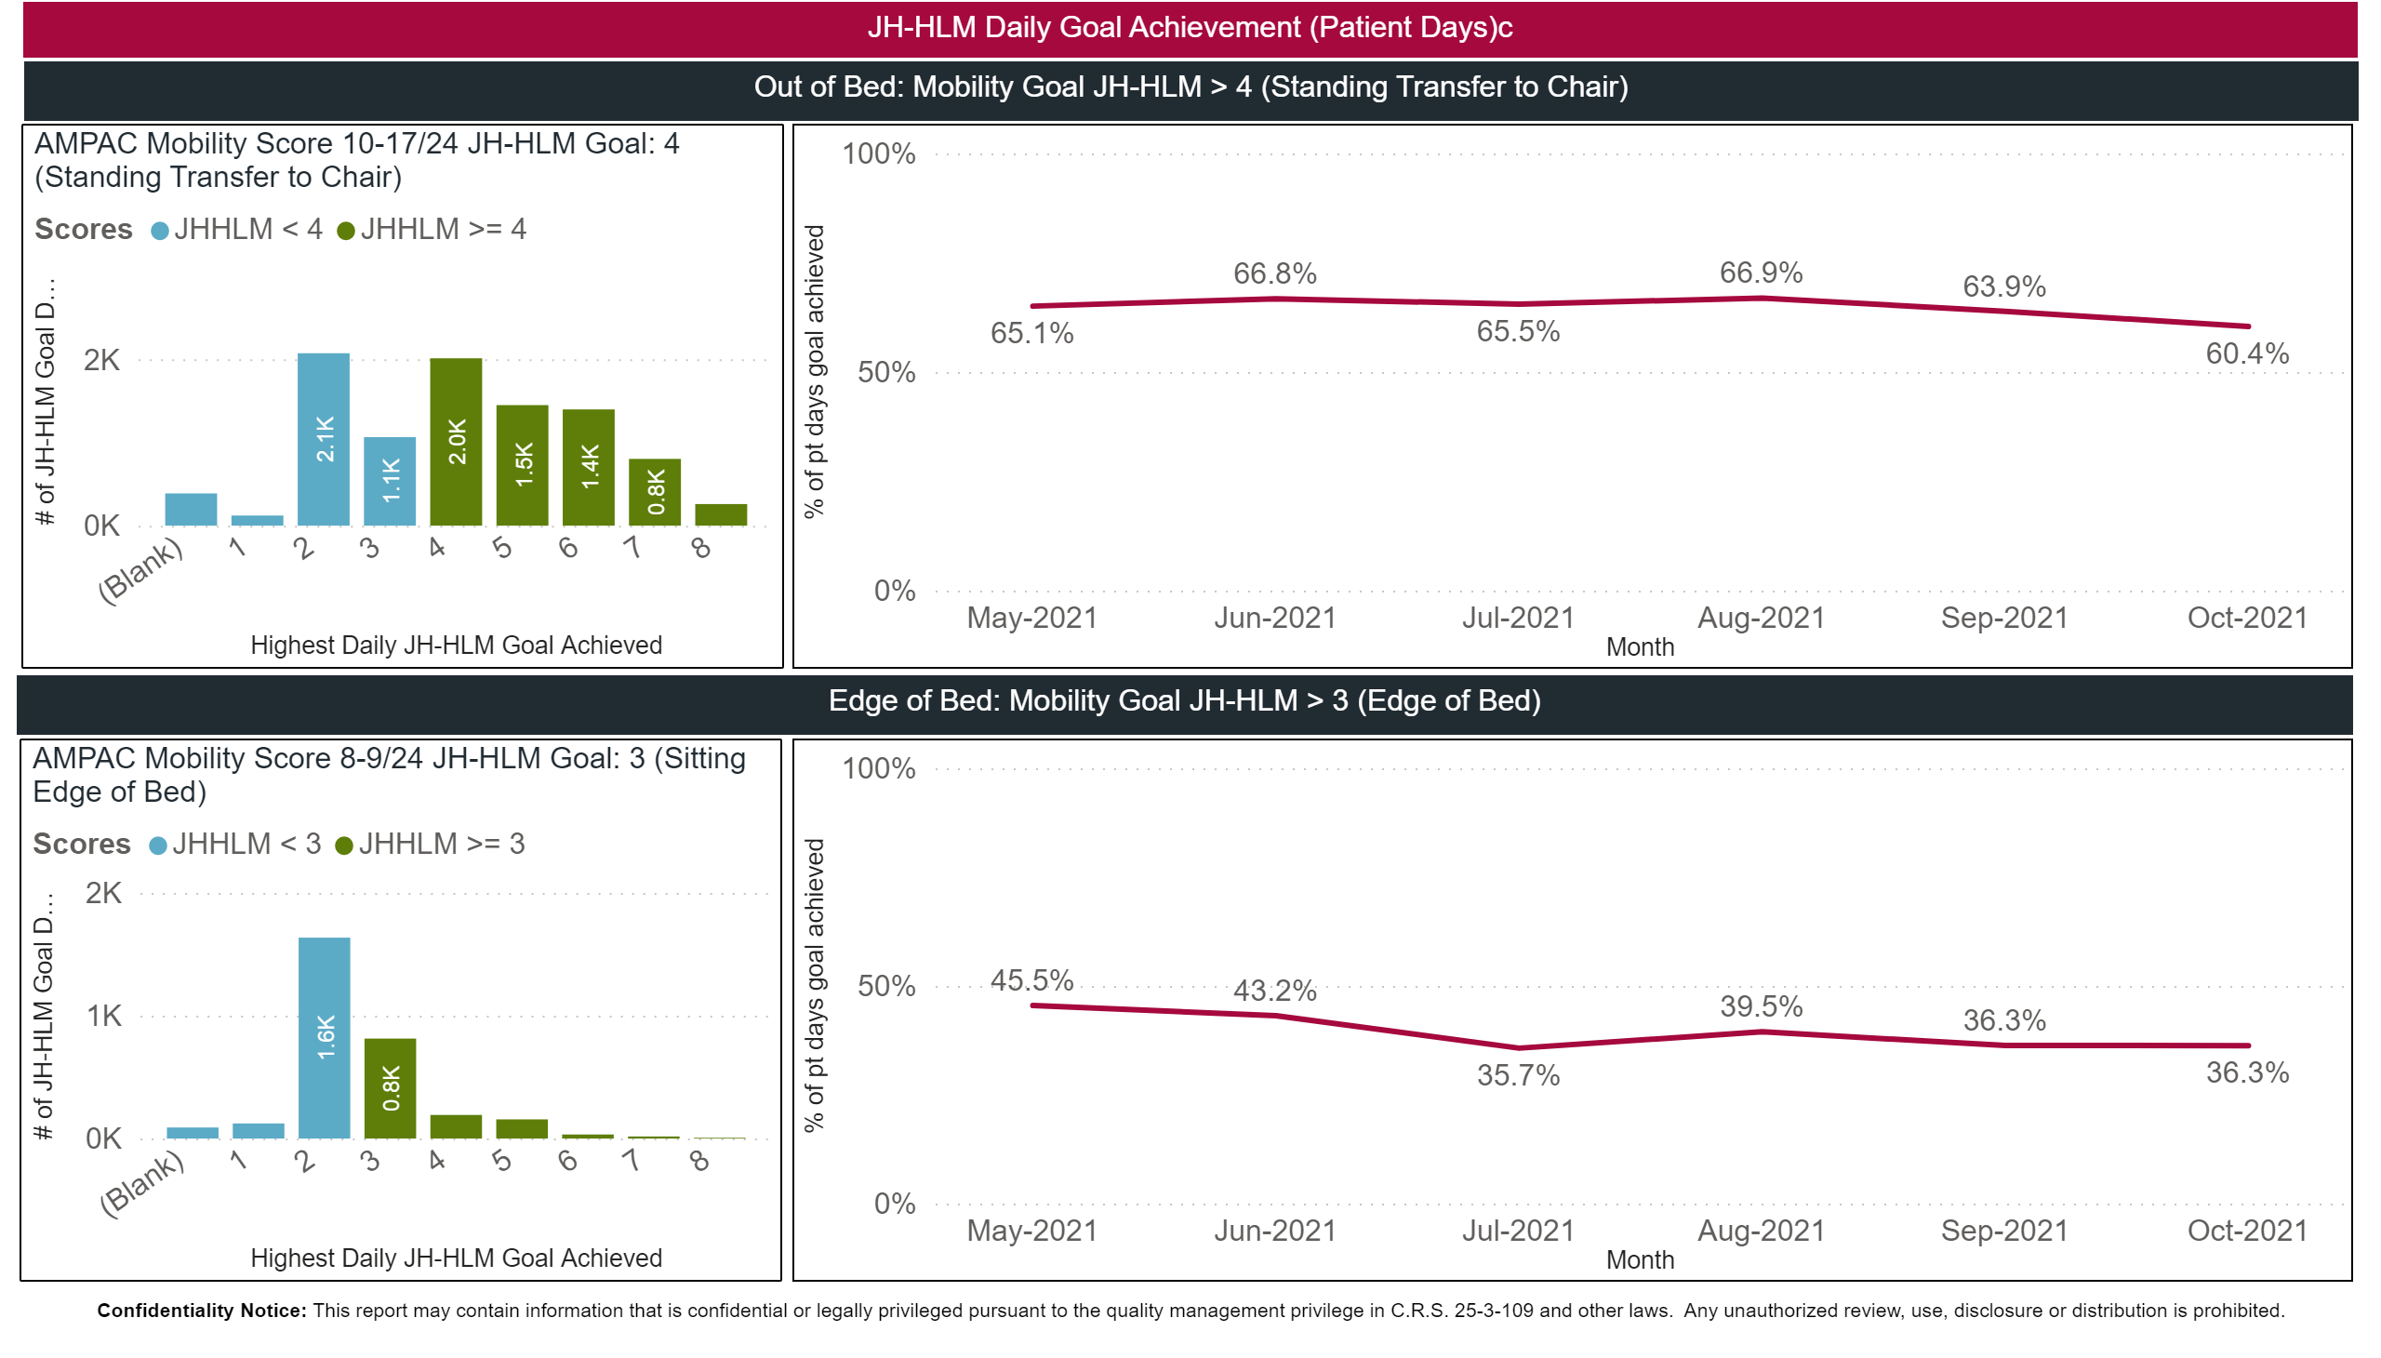
JHHLM_Goal_Achievement_page2

